Slide 1
ENGINEERING AND SUPPORT CENTER, HUNTSVILLE
HNC FF&E Program Overview
January 2023
http://www.hnc.usace.army.mil/

Slide 2
Discussion Topics
HNC Furniture Package Overview
FF&E Package – Best Practices
Design & FFE Procurement Challenges
HNC Overview & Enterprise Initiatives

Slide 3
HNC Furniture Package Overview
Using the District FF&E Package, HNC Develops Furniture Procurement Package
  RFQ
    Non-proprietary Specifications
    Spreadsheet with Quantities & Room Locations
    Statement of Work Describing Required Services
    Furniture & Electrical Plans
  Internal
    IGE
    HNC Correspondence Log
HNC Receives Quotes & Completes Technical Review
Resolve Any Post-Award Furniture Issues

Slide 4
FF&E Package – Best Practices
Complete the FF&E package per UFC 3-120-10
Confirm that all items in the FF&E package are currently on GSA schedule.
Include at least two alternates for each product
  Researched & vetted to be equals
  GSA schedule
Avoid specifying proprietary features in description section
Consider facility type
Consider average GSA pricing when selecting products

Slide 5
FF&E Package – Best Practices
Coordinate Furniture Requirements with Building’s Electrical & Telecom Plans
  Example of Uncoordinated Furniture Plans – Workstations requiring hardwire connection specified but only wall outlets are specified in the electrical drawings
    Often, either the workstations are modified with open tiles at wall out locations or a different product is specified
Recommend Including Funding Sources - IMCOM typically will not fund the following:
  Height Adjustable Tables/Desks, Safes, High Density Storage, Appliances for Admin Facilities, Garbage Disposals, Wall-mounted Overheads, Fire Extinguishers, Walk-off Mats, Standard Clocks

Slide 6
Design & FF&E
Procurement Challenges
TIME: FF&E procurement tends to be 3-5 yrs after initial design
  POC & User Group changes
  Products & fabrics discontinued and require reselection
  Changes to facilities based on organizational & operational needs closer to procurement timeline that result in changes to original FFE specifications
HNC may participate in design reviews, but this doesn’t prevent user requested changes later in the procurement process
  HNC design reviews help with identifying any user funded FFE, electrical and AV/IT concerns
  Also allows for the integration of HNC in overall execution of design and through construction versus HNC coming in late and identifying issues that must be worked in last phases of construction
HNC is obligated to IMCOM for FF&E procurement
  Responsible for ensuring facilities are outfitted per policy and regulations
  Customer preferences and wants can usually be accommodated
  within reason

Slide 7

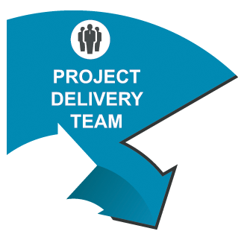
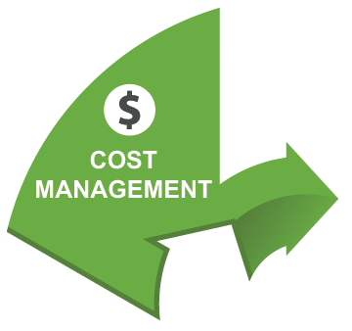



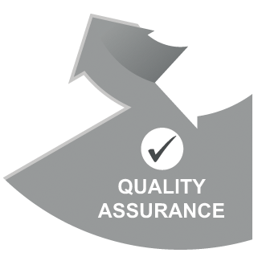
Why Huntsville?
Full-service Project Delivery Team (PDT) with over 25 years of experience that improves and sustains federal agency performance while saving taxpayer dollars

Slide 8
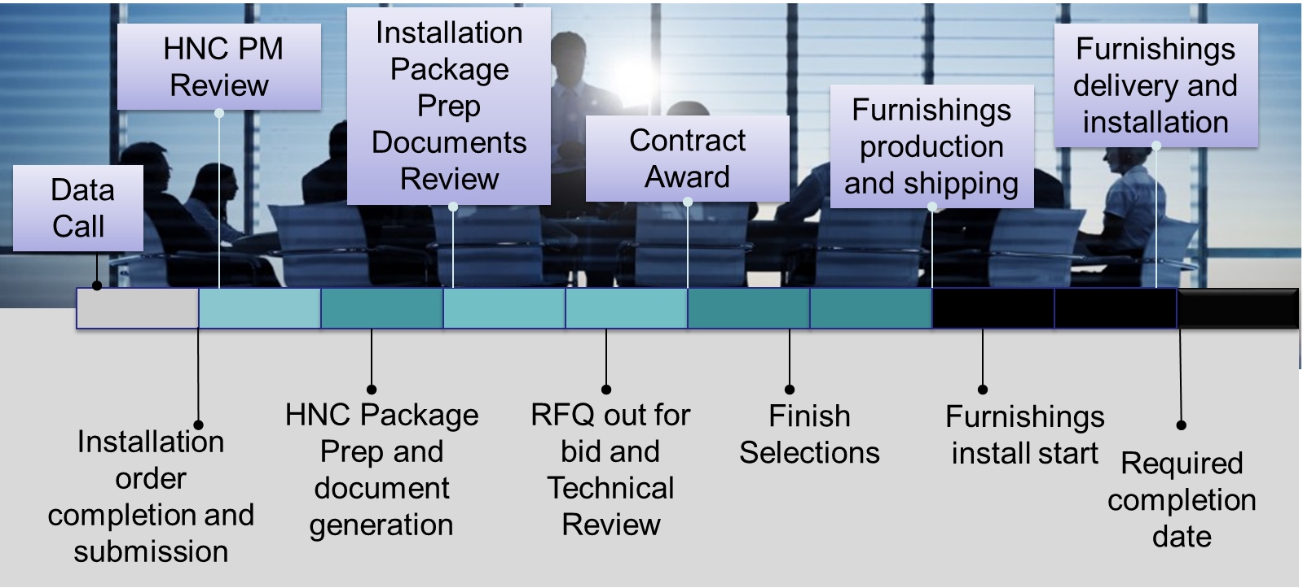
Effective Process
Streamlined process from order receipt to contract closeout
Standardized product offering for standard designs to ensure consistency throughout all facilities
Technical PDT ensures accuracy of space planning, application of product, power and data requirements and life safety
PDT implementing online platform for furnishing orders that will provide automation and real time reporting throughout the process

Slide 9

Historical Cost Savings
On average, HNC procures over $100-125M in furnishings annually
96% of projects are within schedule and under budget
Longer lifecycle due to tailored specifications and warranty requirements
Approximately 70% of awards go to small businesses (SB)
100% of awards are Firm Fixed Price
FY 2022
$140 MILLION
16%
$485 MILLION

Slide 10
Enhanced Warranty
Administrative Product
Product Type | HNC | Other
Wood Products | 10 yrs | 1 yr
Systems Workstations | 10 yrs | 1 yr
Laminate | 5 yrs | 1 yr
Fabric | 3 yrs | 1 yr
Ergo Task Chairs
Mechanisms | 10 yrs | 1 yr
Foam (up to 300 lbs) | 5 yrs | 1 yr
Fabric | 5 yrs | 1 yr
Training Tables | 10 yrs | 1 yr
Laminate | 5 yrs | 1 yr
Unaccompanied Housing Product
Product Type | HNC | Other
Wood Casegoods | 10 yrs | 7 yrs
Metal Casegoods | 10 yrs | 5 yrs
Drawer Glides | 10 yrs | 5 yrs
Laminate | 10 yrs | 5 yrs
Lounge Seating
Fabric | 5 yrs | 1-2 yrs

Slide 11
Points of Contact
Program Management
Sara Cook
Program Manager
(256) 895-7210
Sara.D.Cook@usace.army.mil
Stephanie Hardin
Senior Project Manager
(256) 895-1512
Stephanie.R.Hardin@usace.army.mil
Interior Design
Stephanie Woods
Lead Interior Designer
(256) 895-1845
Stephanie.D.Woods@usace.army.mil
http://www.hnc.usace.army.mil/
Furniture Program - http://youtu.be/gUUQZ-x_xqQ

